Slide 1
Advantages and Disadvantages of Oxygen Administration
Student’s Name
Course title
Date

Slide 2
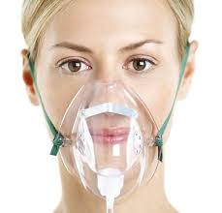
Introduction
Oxygen administration is a treatment method that uses oxygen to treat different types of ailments. The method is commonly referred to as supplement therapy because it is mostly used as a support for other treatment methods.
Some of the ailments that this method is used to treat include; low blood oxygen, cluster headaches, carbon monoxide toxicity and maintaining of enough oxygen on patients using inhaled anesthesia (Travers & Carlo, 2019).
The oxygen administration needs to be done by a qualified and competent professional who has the necessary training. Special equipment also needs to be used for the administration to be effective.

Slide 3
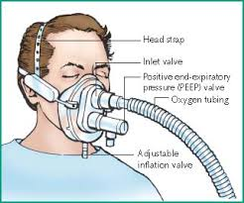
Advantages Of oxygen Administration
The main advantage of oxygen administration is that it works within a short time. It takes just a few minutes for the oxygen to get into the heart and into the blood system. The fast working time allows the method to be used in treating emergency ailments which require fast response.
Oxygen administration can be done on almost anyone including children who might be suffering from the various outlined ailments. Even infants who might be suffering from oxygen deficiency are saved through this method. The medical practitioners doing the administration just need to regulate the oxygen flow depending on the person being treated.

Slide 4
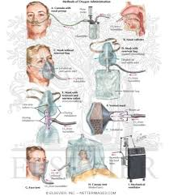
Advantages of oxygen administration continued
Administering oxygen is simple provided it is done in the right manner. This has allowed the method to be used even in relatively small and medical facilities. Ambulances also carry the equipments needed for the administration so that they can treat patients who require oxygen urgently.
The method does not involve any chemicals and this makes it safer. Only pure oxygen is used and this means that patients cannot experience unnecessary side effects. All what is needed is the administration to be done using the right techniques.

Slide 5
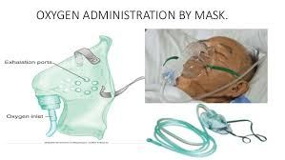
Disadvantages of Oxygen Administration
The method provides temporally solutions where patients are required to undergo further treatments. It is not a permanent solution when administered on patients with different related ailments. This is despite the fact that it helps a lot of patients who require urgent supplies of oxygen.
The method is costly where some people might not be able to afford it. This is especially patients who require regular supply of oxygen because of conditions such as cluster headaches. Such patients need to spend a lot to make sure they have oxygen with them at almost all times.

Slide 6
Reference
Travers, C. P., & Carlo, W. A. (2019). New Methods for Noninvasive Oxygen Administration. Clinics in perinatology, 46(3), 449-458.

